Slide 1
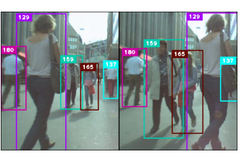
Human Tracking and Detection using Machine Learning
A brief presentation by Arnav Singh A2305219087
NTCC IN-HOUSE PROJECT
Notes:
Good Morning everyone, today I, Arnav Singh from CSE2 shall be briefly presenting my INHOUSE project; Human Tracking and Detection using Machine Learning.

Slide 2
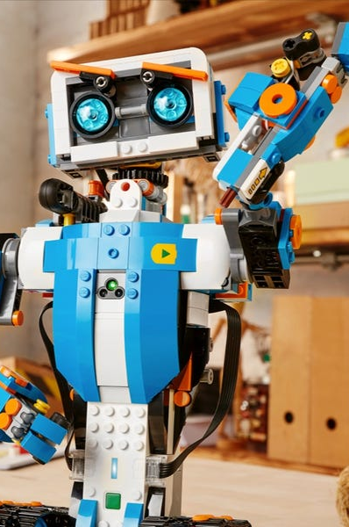

PROBLEM STATEMENT
With advancing technology, security and safety concerns are paramount.
Human tracking will not only be beneficial for security concerns but also could be used:
Conducting Surveys
Robotics
Ethical Hacking
Notes:
While it could be said that technology is being shrunk to such an extent that everything could be kept in our pockets, the security of such products cannot be taken for granted. The security of everything, be it our personal products, phones, wallets or even our homes for this case, should be the number one priority.

Slide 3
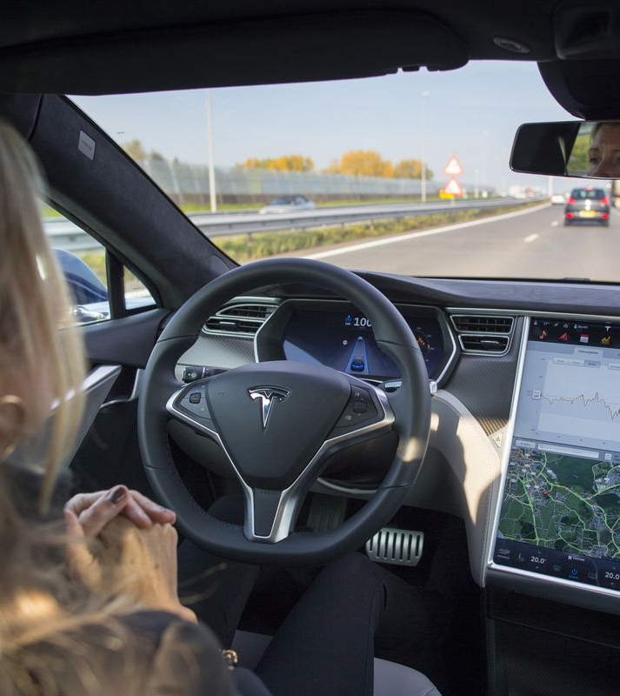
Purpose/motivation
Human/Pedestrian tracking through physical webcam
Used in Self-driving automobiles
Used in surveillance systems
Used in home security systems
Notes:
So, purpose or the motivation for this project was generally to program Pedestrian tracking through a physical webcam which could be used in self-driving automobiles like a Tesla shown in the picture in front of you. It could also be used in surveillance systems or human security systems.

Slide 4
methodology
First, it reads a video and processes each frame one by one.
01
For each frame, it tries to detect a human. If a human is detected it draws a rectangle around it.
02
After completing step 2, it tries to detect the human face.
03
If a human face is detected it tries to recognize it with a pre-trained model file.
04
If the human face is recognized it puts the label on that human face else, it moves to step 2 again for the next frame
05

Slide 5
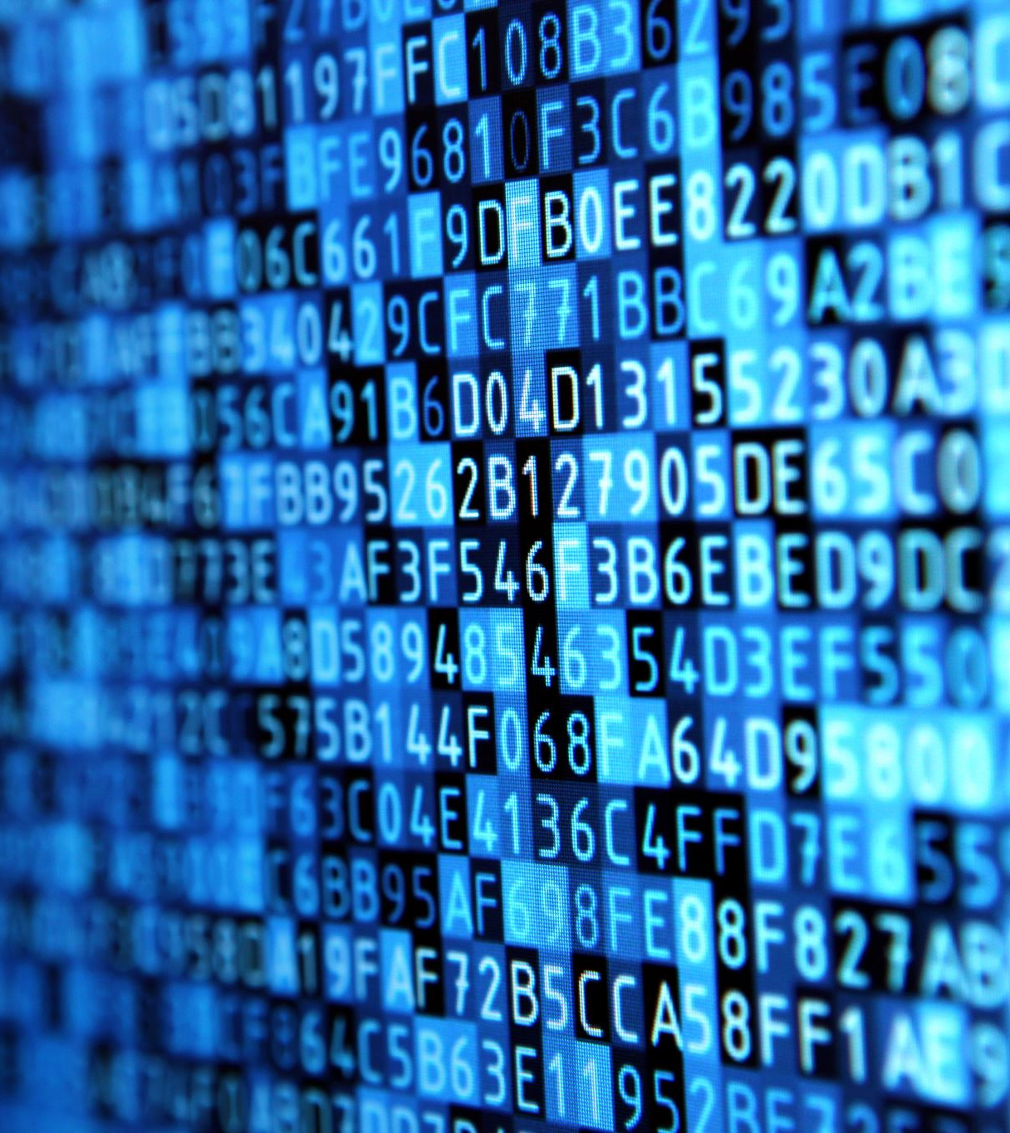
Requirements
Functional Webcam for Tracking
Python 3.9
OPENCV
IMUTILS
NUMPY
ARGPARSE
Notes:
OPENCV: OpenCV is the huge open-source library for the computer vision, machine learning, and image processing and now it plays a major role in real-time operation which is very important in today's systems. By using it, one can process images and videos to identify objects, faces, or even handwriting of a human.
IMUTILS: Imutils are a series of convenience functions to make basic image processing functions such as translation, rotation, resizing, skeletonization, and displaying images.
NUMPY: NumPy is a Python library used for working with arrays. It also has functions for working in domain of linear algebra, Fourier transform, and matrices.
ARGPARSE: Argparse is the “recommended command-line parsing module in the Python standard library.” It is what you use to get command line arguments into your program.

Slide 6
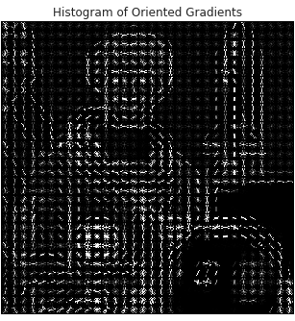
IMPLEMENTATION
HOG ( HISTOGRAM OF ORIENTED GRADIENTS )
SVM ( SUPPORT VECTOR MACHINE )
HOG + SVM = BASIS OF OUR PROJECT
Notes:
The histogram of oriented gradients (HOG) is a feature descriptor used in computer vision and image processing for the purpose of object detection. The technique counts occurrences of gradient orientation in localized portions of an image.
In machine learning, support-vector machines are supervised learning models with associated learning algorithms that analyse data for classification and regression analysis.
For our convenience, OpenCV has already been implemented in an efficient way to combine the HOG Descriptor algorithm with Support Vector Machine or SVM.

Slide 7
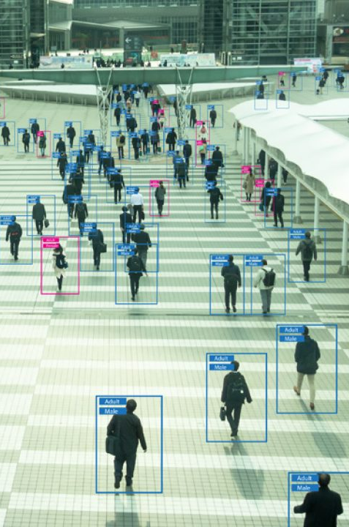
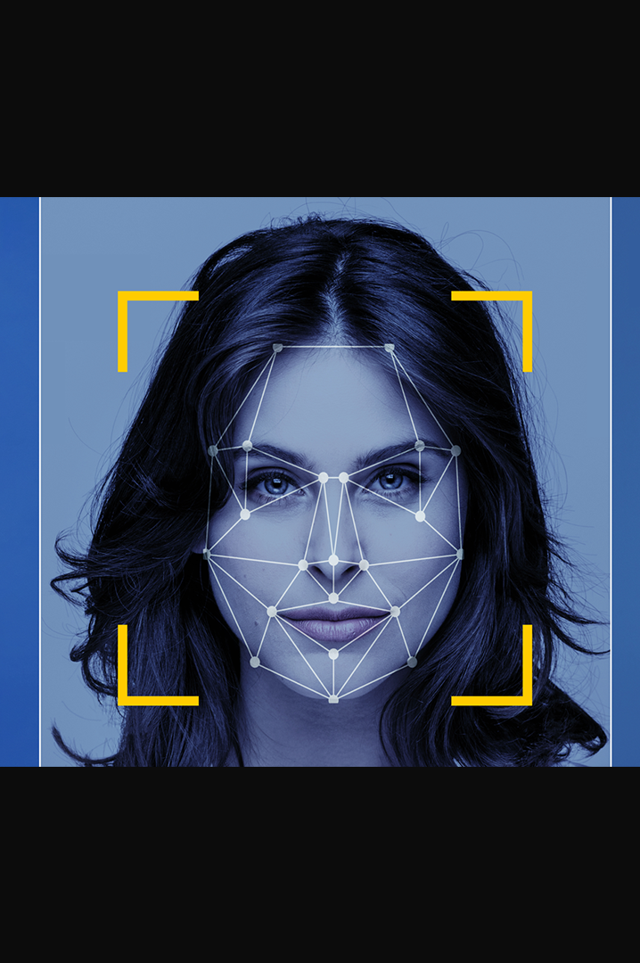
Applications
Video Recognition
Image Recognition
Live Webcam Feed Recognition

Slide 8
FUTURE SCOPE
The future scope for this project could be to improve the performance of this code. It could also be beneficial to improve the human recognition of the code.

Slide 9
REferences
[1]
Human Detection and Tracking Encyclopedia of Biometrics, 2009 James W. Davis, Vinay Sharma, Ambrish Tyagi, Mark Keck
[2]
C. Li, L. Guo and Y. Hu, "A new method combining HOG and Kalman filter for video-based human detection and tracking," 2010 3rd International Congress on Image and Signal Processing, 2010
[3]
Multimodal Approach to Human-Face Detection and Tracking Prahlad Vadakkepat, Senior Member, IEEE, Peter Lim, Liyanage C. De Silva, Liu Jing, and Li Li Ling
[4]
Paul, M., Haque, S.M.E. & Chakraborty, S. Human detection in surveillance videos and its applications - a review. EURASIP J. Adv. Signal Process. 2013
[5]
Gajjar, Vandit & Gurnani, Ayesha & Khandhediya, Yash. (2017). Human Detection and Tracking for Video Surveillance A Cognitive Science Approach.

Slide 10

Thank you

